Slide 1
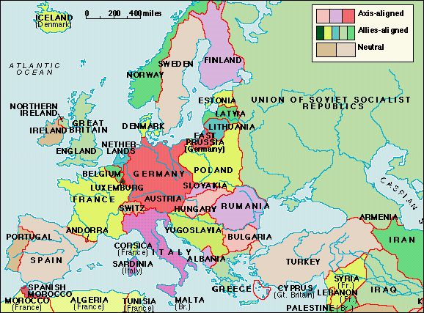
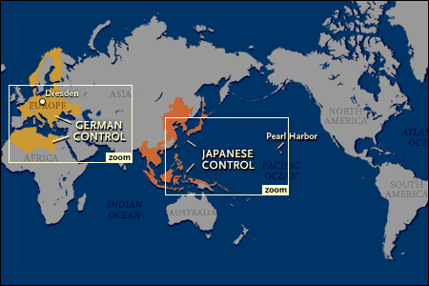
The War to End all Wars – Round Two

Slide 2
Hitler's Agenda ’19-’33
Unification of all German people
Rebuild a Strong Germany
- “Deutschland über Alles”
End of the Treaty of Versailles
National Army
Expulsion of the Jews
Lebensraum
After Hitler is sentenced to 9 months in prison (1924), he writes Mein Kampf where he outlines the direction he wanted to take Germany

Slide 3
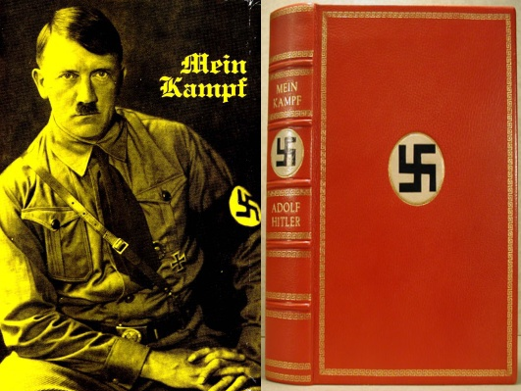
Mein Kampf
Major Points include:
Anti-Semitism and militarism
Hatred for Communists
Historic destiny of German people
Lebensraum
Hitler wanted to destroy the parliamentary system
Hitler blamed Germany's chief woes on the parliament of the Weimar Republic, the Jews, and Social Democrats, as well as Marxists

Slide 4
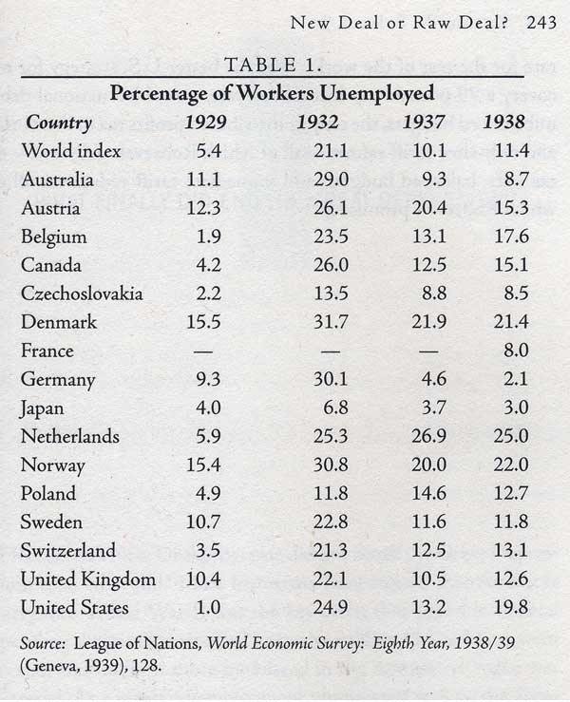
Hitler’s Rise to Power
Great Depression
Undermined the League’s authority
Germany faced a severe unemployment rate (6 million 1933)
Hitler is appointed Chancellor by General von Hindenburg (Example of when a democracy can fail)
One of Hitler’s first steps was to appeal to the Army and the industrialists (JOBS!!!)
Hitler sets up a totalitarian regime similar to Mussolini’s and Stalin’s

Slide 5
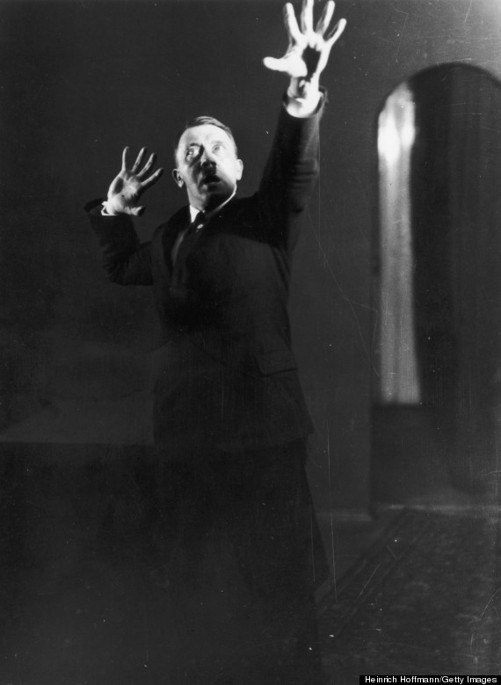
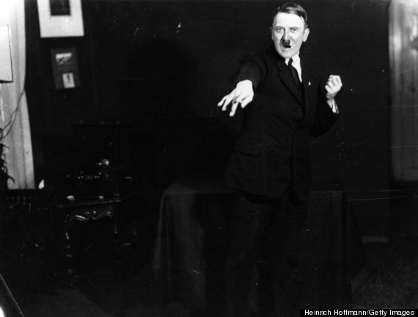
Practicing his Act
In 1925, Hitler hired Heinrich Hoffmann to photograph him while practicing speeches to measure the power of his gestures and better link them to his rhetoric. He asked Hoffmann to burn the negatives. He did not.

Slide 6
Questions:
From what you read so far, what evidence is there that Hitler had a long term plan that would lead to a European War?
2. To what extent do you agree that the Nazi’s popularity was due to the economic crisis in Germany?

Slide 7
Short Term Causes of WWII
Lebensraum—race and space. Racial purity and German “elbow room” (This would come at the Soviet Union’s expense)
Treaty of Versailles
When Hitler became Chancellor in 1933 he announced Germany would not resume payments
Hitler also announced that Germany was going to rearm German military which was a direct concern for France
Hitler leaves the Disarmament Conference trying to blame France for embracing disarmament (Left League in 1933)
Hitler increased military spending 5x in 1934-35

Slide 8
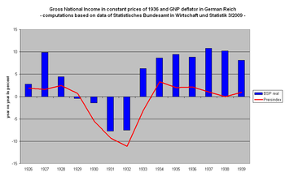
Why do many Germans like Hitler in 1933?

Slide 9
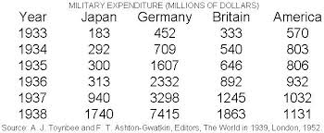
What does this chart show about Hitler’s plan?

Slide 10
Question
To what extent do you agree that Germany was the only country causing tension in Europe in the first half of the 1930’s?

Slide 11
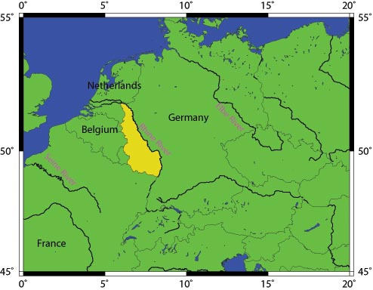
Germany remilitarizes the Rhineland
The Rhineland had been demilitarized under the Treaty of Versailles.
Hitler’s argument was that he was trying to fix the wrongs under the Treaty of Versailles. He brought in 22,000 troops in 1936.
Hitler promised that he would leave once the French military showed up. (They never came.)

Slide 12
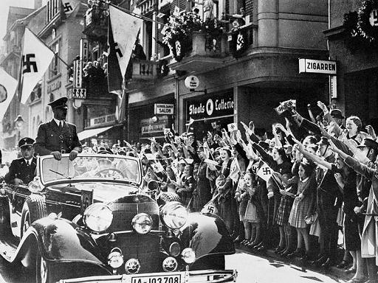
No Anschluss!!!
Hitler’s first attempt at unifying Austria failed in 1934 when Austria along with Italy’s help crushed the attempt.
In 1938, Hitler invades Austria without firing a shot, thus unifying them with Germany in a policy he outlined in his book Mein Kampf.
This was strictly forbidden in the Treaty of Versailles.

Slide 13
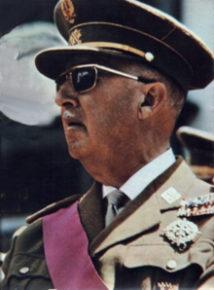
Spanish Civil War
10,000 German troops in Spain
70,000 for Italy
Appears Hitler was giving his troops “on the job training”
Tested civilian bombing techniques
In 1939, Franco becomes the military dictator of Spain

Slide 14
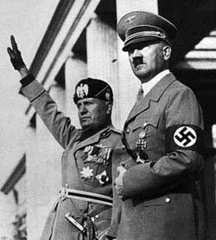
The Axis Begin to Unify
Rome-Berlin (Anti-Cominterm Pact)
’36-Hitler first combines with Italy
‘36-Germany signs an agreement with Japan
In ‘37 Italy joins German and Japan forming the Rome-Tokyo-Berlin Pact

Slide 15
Hossbach Memorandum
Now please, take out your textbooks
Pg. 118

Slide 16
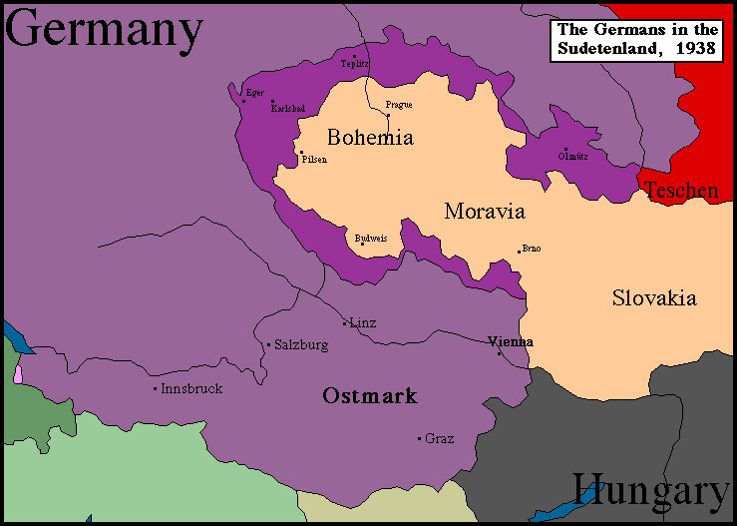
Czechoslovakia
In May of 1938, Hitler retakes the Sudetenland.
Czech leader Edvard Benes appealed to France and Great Britain for help.
On September 29, 1938, Britain, France and Italy agreed to Hitler’s demands giving him all of the Sudetenland (Munich Conference)
March 1939, Hitler takes all of Czechoslovakia.

Slide 17
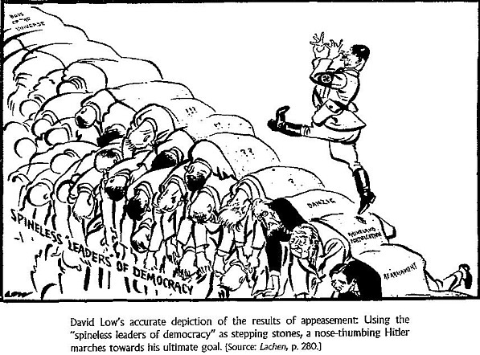
Munich Conference

Slide 18
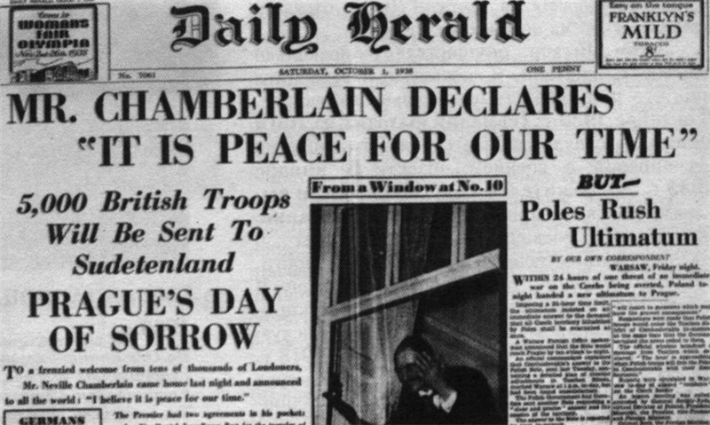
Chamberlains failed attempt at Peace

Slide 19
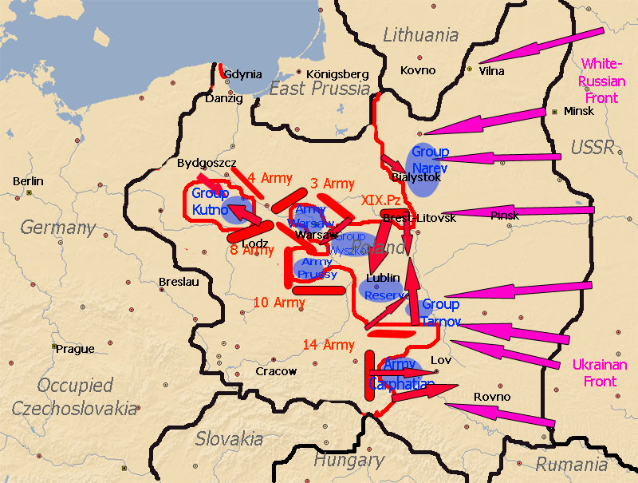
Immediate Causes of WWII
Non Aggression Pact (1939)
a. What were Hitler’s motives for reaching an agreement with the Soviet Union?
b. What were Stalin’s motives for reaching an agreement with Germany?
Invasion of Poland
Most immediate cause
Chamberlain and Albert Lebrun announce their support for Poland
September 1, 1939 Germany invades Poland thus starting WWII

Slide 20
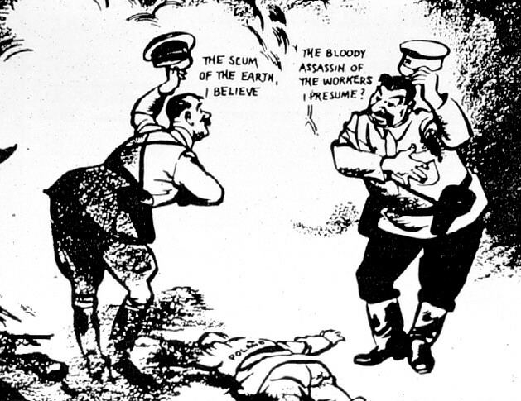
What is the message of this 1939 cartoon?

Slide 21
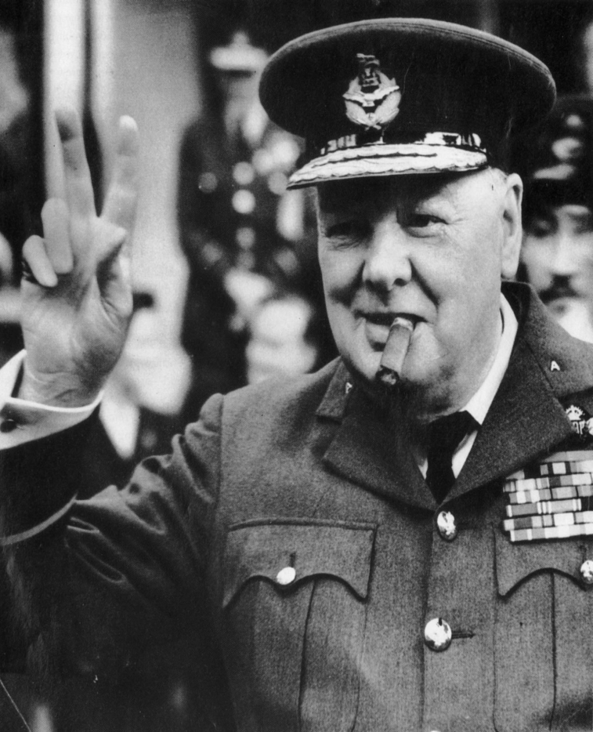
Failure of Appeasement
To what extent was appeasement a cause of WWII?
“We should seek by all means in our power to avoid war, by analysing possible causes, by trying to remove them, by discussion in a spirit of collaboration and good will. I cannot believe that such a programme would be rejected by the people of this country, even if it does mean the establishment of personal contact with the dictators.”
—Neville Chamberlain
“An appeaser is one who feeds a crocodile, hoping it will eat him last”
—Winston Churchill

